Slide 1
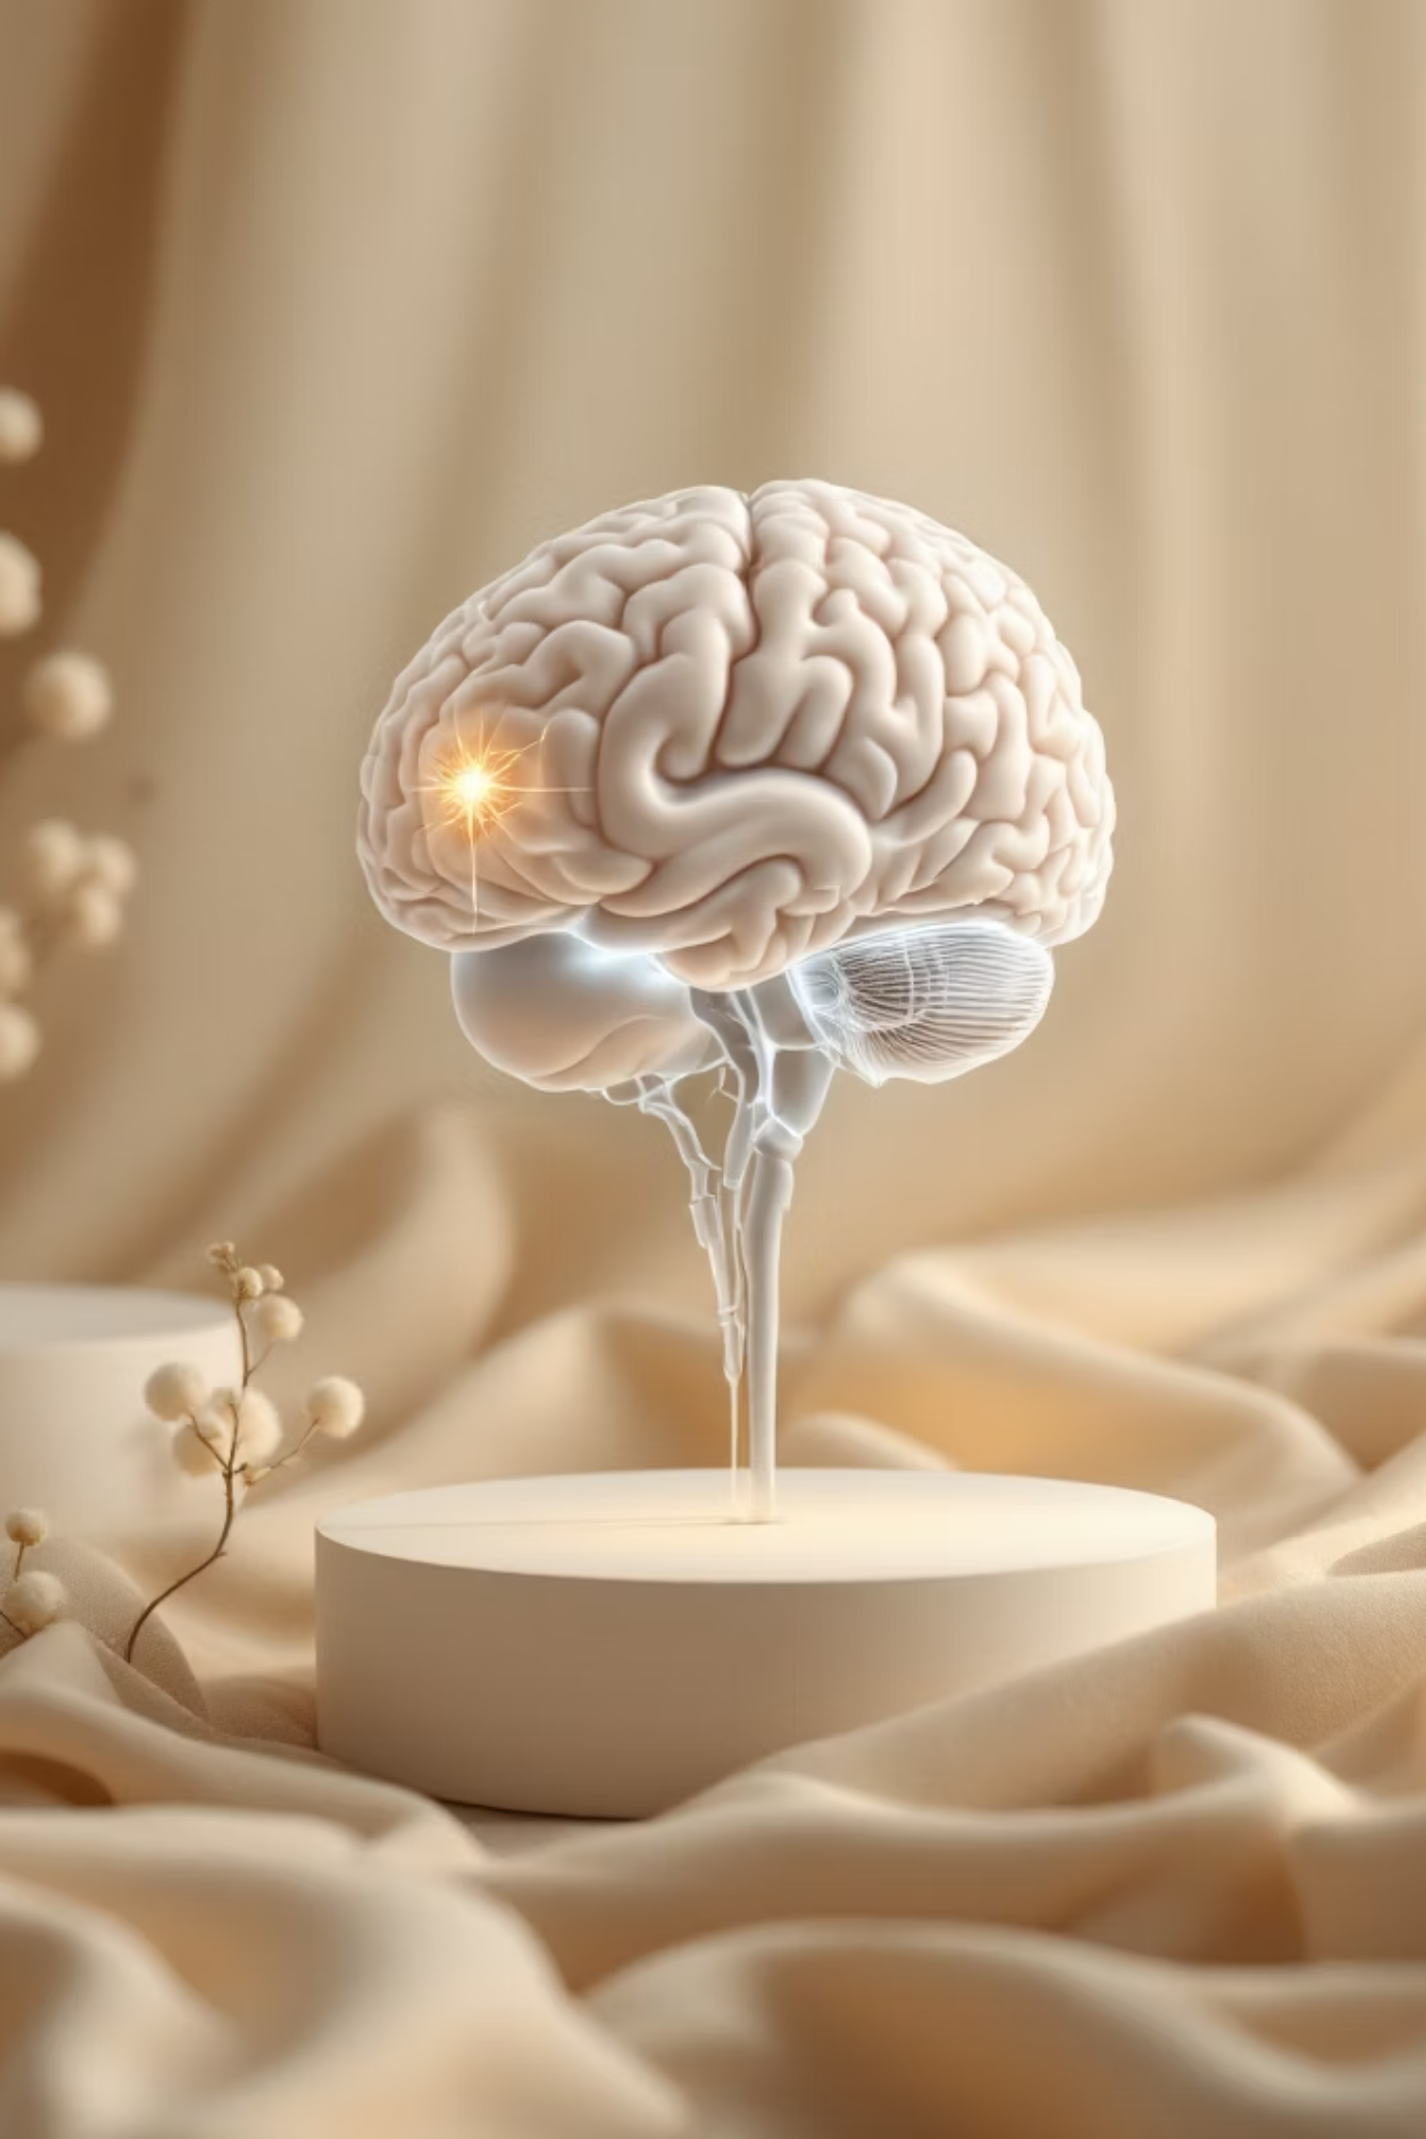
Applying CNN to MRI Images to Diagnose Brain Tumors
A deep learning approach using MATLAB preprocessing and CNNs for automated brain tumor diagnosis.
Done by:
Vignesh Chivirala BT23ECI031
Aprameya goud BT23ECI035
Sreeja Muthurla BT23ECI048
A.Vijay Teja BT23ECI059
Under the Guidance of
Dr. Tapan Jain

Slide 2
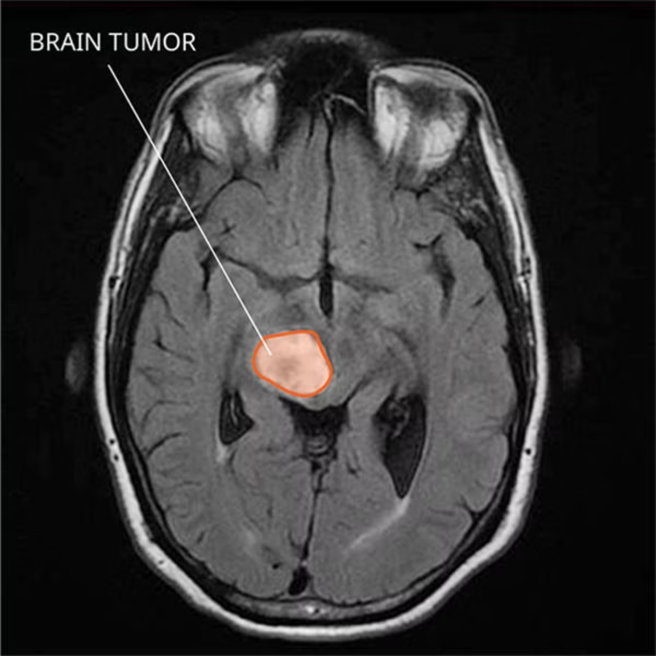
The Challenge of Brain Tumor Diagnosis
The Problem
Brain tumors require early detection for effective treatment, yet manual MRI analysis is time-consuming and prone to subjective interpretation. Traditional methods struggle with boundary precision and intensity differentiation.
Our Solution
We integrate CNNs with MATLAB preprocessing to automate tumor detection. The pipeline includes noise removal, skull stripping, and intelligent segmentation before classification.
Manual Diagnosis Limits
CNN Advantages
MATLAB Integration
Subjective, slow, requires expert radiologists
Automated, consistent, learns spatial features
Robust preprocessing ensures clean input data

Slide 3
Evolution of MRI Tumor Detection Methods
Traditional Segmentation
1
Otsu thresholding, K-means clustering, and Fuzzy C-Means provided basic region separation but struggled with intensity variations and noise sensitivity.
2
Early Deep Learning
AlexNet, VGG, and ResNet architectures brought feature learning capabilities but required extensive manual preprocessing and large annotated datasets.
Hybrid Approaches
3
Modern CNN integration with MATLAB preprocessing combines classical segmentation robustness with deep learning's pattern recognition power.
Comparative Analysis
Method
Key Limitation
K-Means
Poor intensity differentiation in heterogeneous tumors
Fuzzy C-Means
High sensitivity to noise and artifacts
CNN Architecture
Automatically learns spatial and texture features with superior generalization

Slide 4



Intelligent Water Drops (IWD) Algorithm
The Intelligent Water Drops (IWD) Algorithm is a powerful, nature-inspired optimization technique:
Nature-inspired Optimization
Dynamic Water Drop Behavior
Application in this Project
Based on how water drops carve rivers over time, finding optimal paths in their environment.
Each "water drop" iteratively adjusts its velocity and soil levels while searching for the optimal path.
IWD is applied to optimize segmentation/thresholding parameters, producing smoother and more accurate brain tumor boundaries.
Benefits of IWD
Fast Convergence
Robust Against Noise
Superior Performance
Quickly finds optimal solutions, reducing processing time.
Maintains accuracy even with noisy MRI data, ensuring reliable results.
Outperforms traditional methods like K-Means and FCM alone for this specific task.

Slide 5
System Architecture & Methodology
01
02
03
Image Acquisition
MATLAB Preprocessing
Feature Extraction
MRI brain scans sourced from Kaggle medical datasets and clinical repositories in DICOM/NIfTI formats
Median/Gaussian filtering for denoising, morphological skull stripping, FCM/K-Means segmentation to isolate ROI
Tumor region of interest extracted and normalized for CNN input compatibility
04
05
CNN Classification
Performance Evaluation
Conv2D → MaxPooling → Flatten → Dense layers with sigmoid activation for binary classification
Metrics include accuracy, precision, recall, F1-score, and Dice coefficient for segmentation quality
Development Stack
CNN Architecture
MATLAB R2023a for preprocessing and GUI
Input: 224×224×3 preprocessed MRI
TensorFlow/Keras for CNN training
3 Conv2D layers with ReLU activation
Python 3.8+ for model development
Binary output: Tumor/Non-tumor

Slide 6
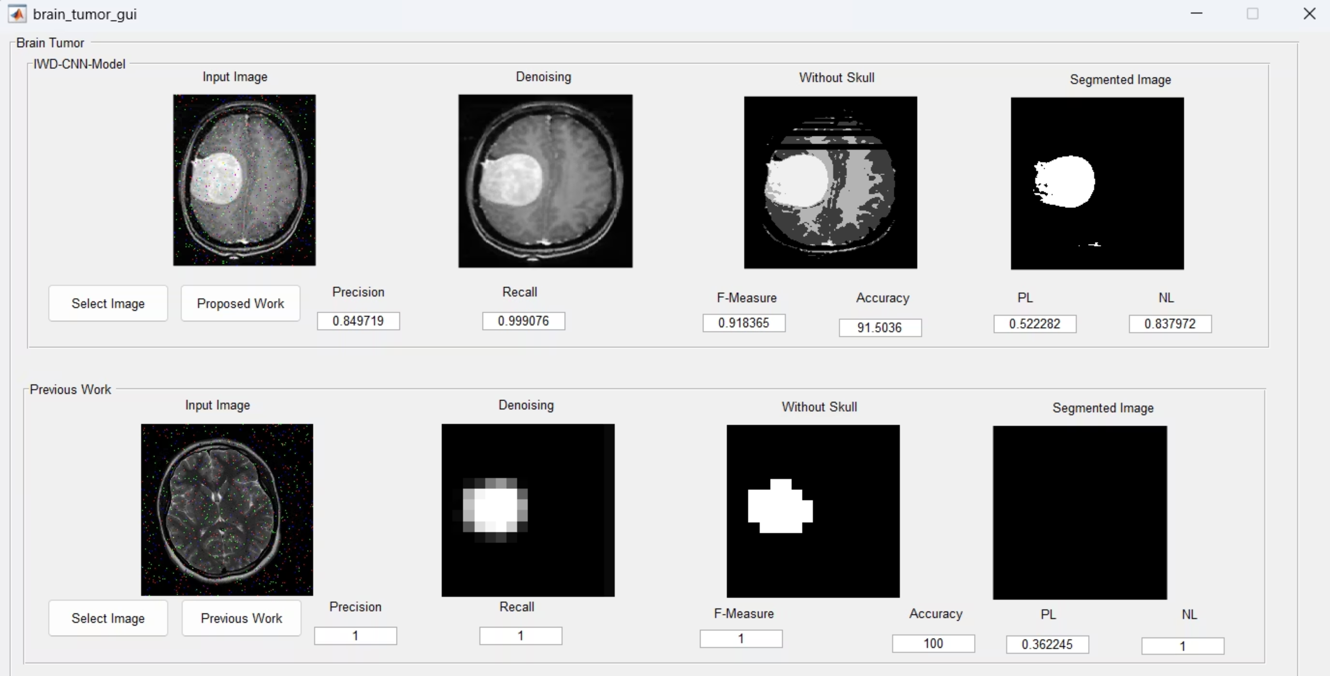
Advanced Results: Visual Analysis & Clinical Validation
A CNN architecture visualization illustrates how raw image data is processed through layers to extract features for classification.

Slide 7



Results & Future Directions
Performance Metrics
Key Findings
96.1%
0.94
The hybrid CNN-MATLAB system significantly outperforms pure clustering methods, reducing diagnostic time while maintaining clinical-grade accuracy. Preprocessing quality directly correlates with model performance.
Accuracy
Precision
Classification accuracy on test dataset
Positive predictive value
0.92
0.93
Recall
F1-Score
Sensitivity measure
Harmonic mean of precision and recall
Future Enhancements
3D Volume Analysis
Multi-Class Classification
Clinical Deployment
Extend to volumetric NIfTI processing for complete tumor characterization
Train models to distinguish glioma, meningioma, and pituitary tumor types
Develop real-time diagnostic web application using MATLAB Web App Server

